Slide 1
My Research
張季祐
Chi-Yu Chang
0985304581
r10922116@ntu.edu.tw

Slide 2
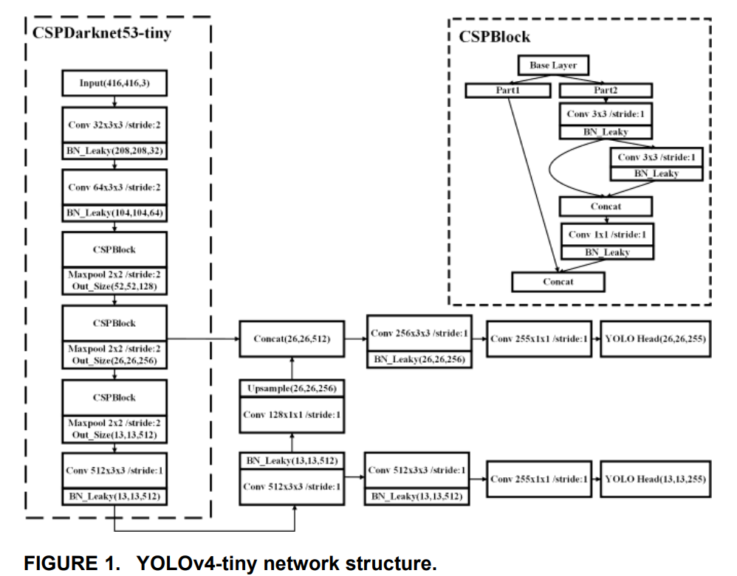
YOLO V4 Tiny
YOLO: You Only Look Once

Slide 3
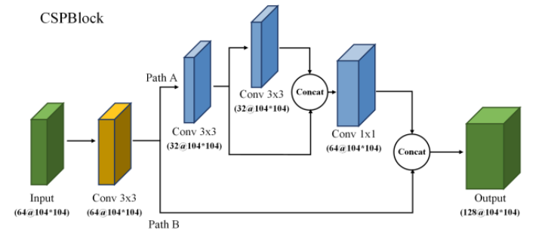
YOLO V4 Tiny
CSPBlock

Slide 4
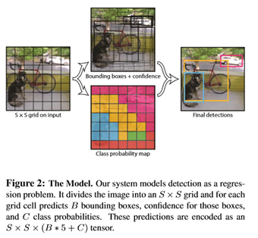
YOLO V4 Tiny

Slide 5
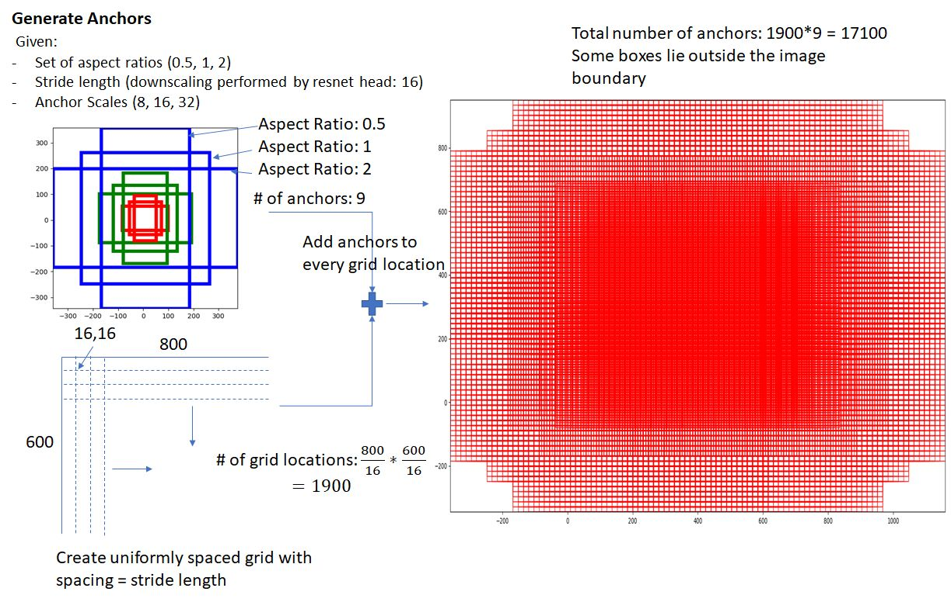
YOLO V4 Tiny
Anchor

Slide 6
YOLO V4 Tiny
Anchor

Slide 7
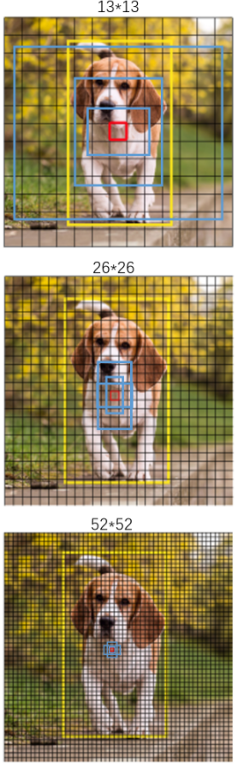
YOLO V4 Tiny
Feature Map Size
13 x 13 x 75
Anchor
VOC Dataset: 20 classes
26 x 26 x 75
Number of final feature map filters =
(number of class + 5) x 3
75 = (20 + 5) x 3
52 x 52 x 75
VOC: Visual Object Classes

Slide 8
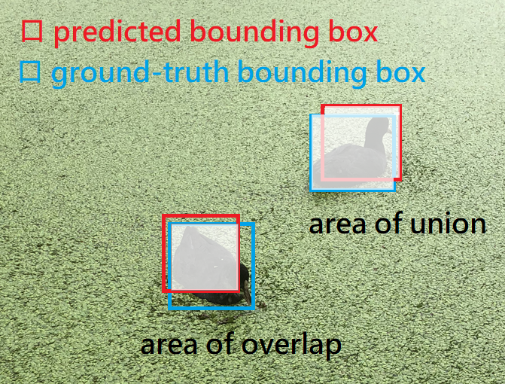
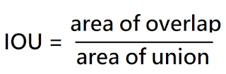
YOLO V4 Tiny
IOU: Intersection Over Union
IOU

Slide 9
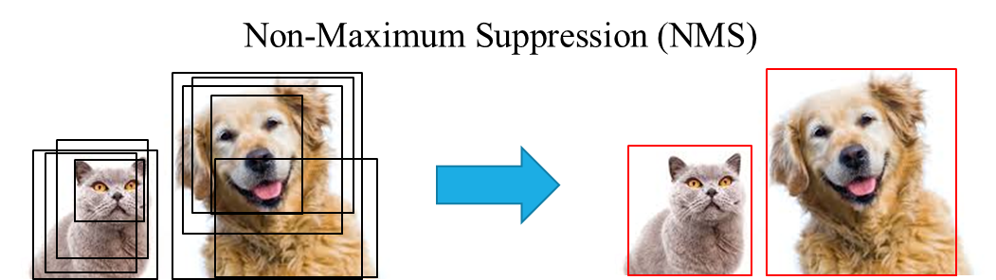
YOLO V4 Tiny
NMS: Non-Maximum Suppression
NMS

Slide 10
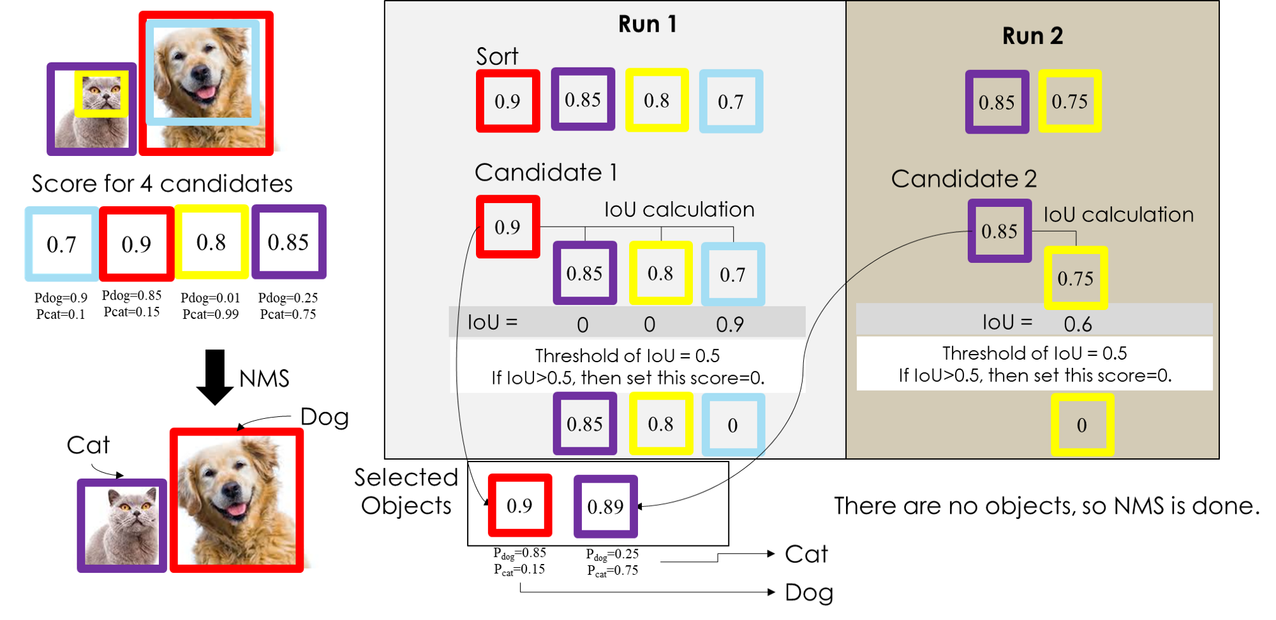
YOLO V4 Tiny
NMS

Slide 11
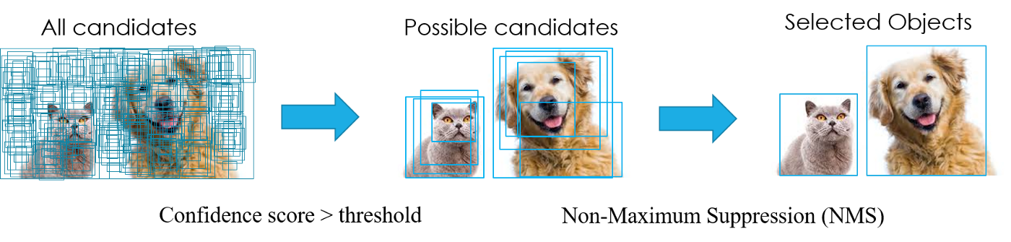
YOLO V4 Tiny
NMS

Slide 12
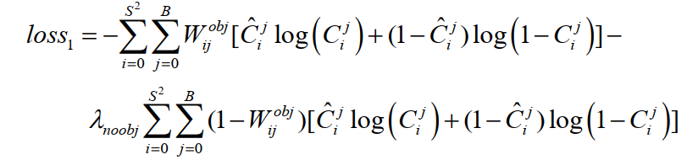
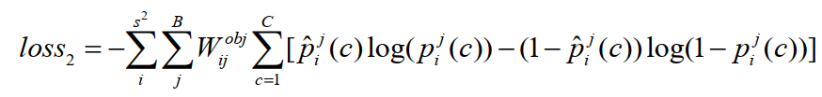
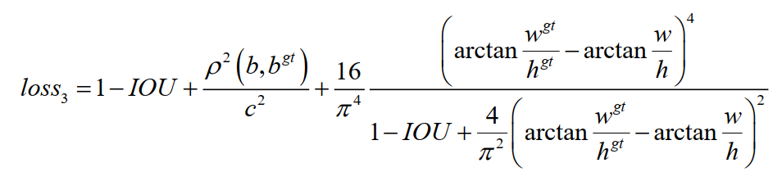
YOLO V4 Tiny
Loss Function
Confidence Loss Function
Classification Loss Function
Bounding Box Regression Loss Function

Slide 13
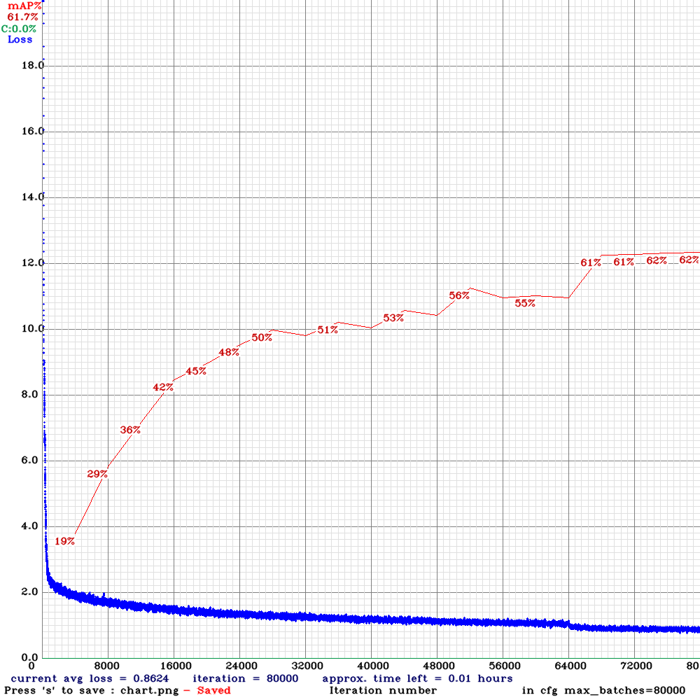
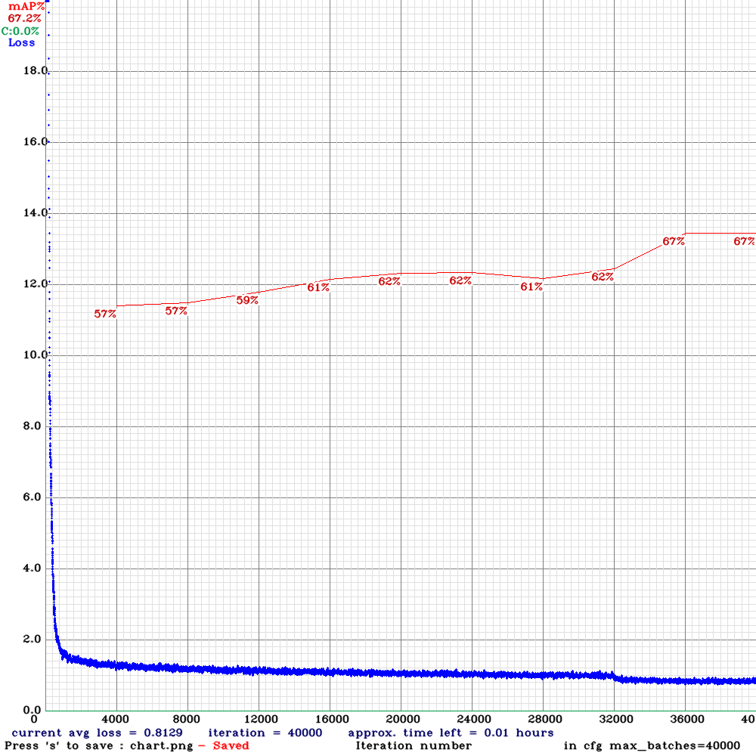
YOLO V4 Tiny
COCO: Common Object in COntext
COCO Dataset: 80classes
VOC Dataset: 20 classes
Pretrained with COCO dataset
Trained with VOC dataset
Importance of Pretrained Weights
Without pretrained weights
With pretrained weights

Slide 14
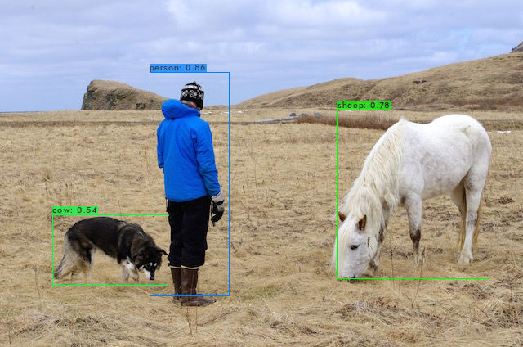
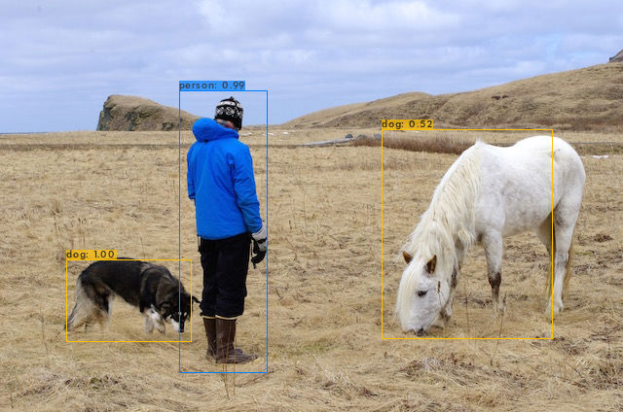
YOLO V4 Tiny
COCO: Common Object in COntext
COCO Dataset: 80classes
VOC Dataset: 20 classes
Importance of Pretrained Weights
Without pretrained weights
With pretrained weights

Slide 15
3x3 Convolution or 4x4 Convolution
Symmetrical feature map
Problem of pixel shift
Inconvenient for Padding

Slide 16
Prospect
Convolution Experiments
Change YOLOV4-Tiny structure based on 4x4 convolution
I’m here
Accelerate convolution operations based on Jeilin hardware instead of Nvidia Hardware

Slide 17
Network slimming
level Sparsity
Fine-grained level sparsity
higher compression rate
requires special software or hardware accelerators to do fast inference.
weight-level
the coarsest layer-level sparsity
does not require special packages to harvest the inference speedup, while it is less flexible as some whole layers need to be pruned.
kernel-level, channel-level, layer-level

Slide 18
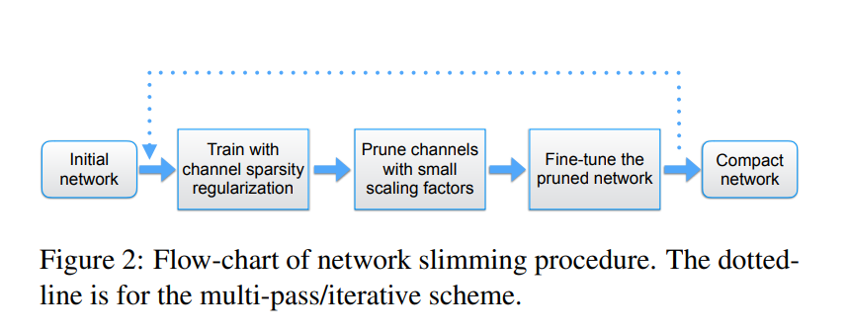
Network slimming
Channel-level Sparsity

Slide 19
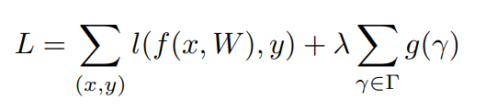
Network slimming
Channel Pruning and Fine-tuning
many scaling factors are near zero >>> prune channels with near-zero scaling factors
we prune 70% channels with lower scaling factors by choosing the percentile threshold as 70%.
Pruning may temporarily lead to some accuracy loss, when the pruning ratio is high.
But this can be largely compensated by the followed fine-tuning process on the pruned network.

Slide 20
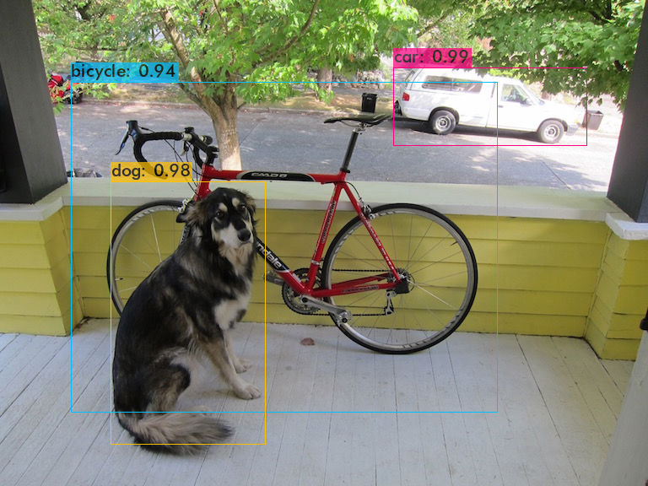
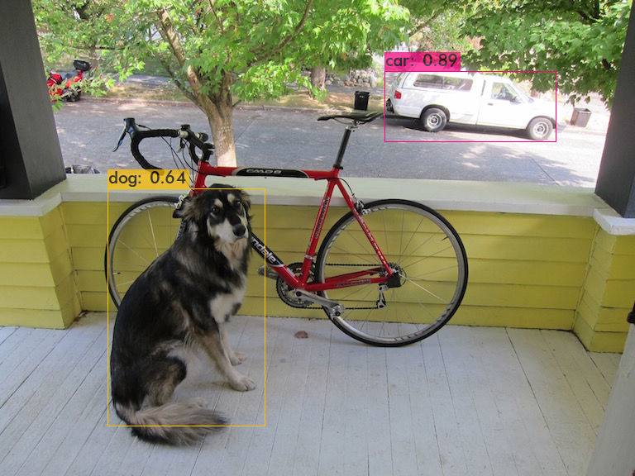
Original
Reduce 50% parameters

Slide 21
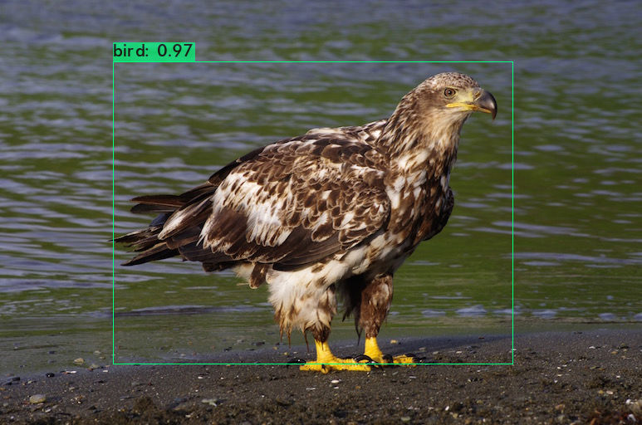
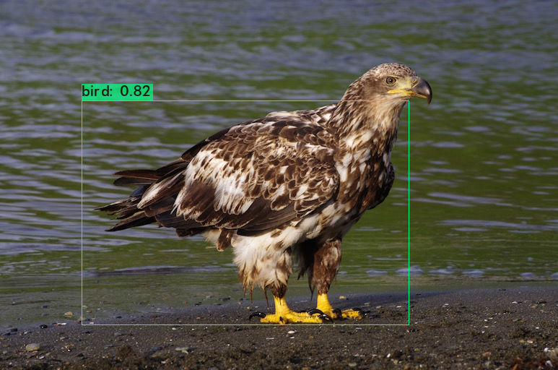
Original
Reduce 50% parameters

Slide 22
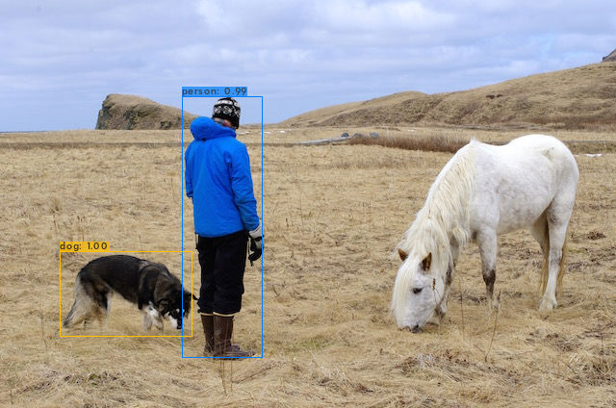
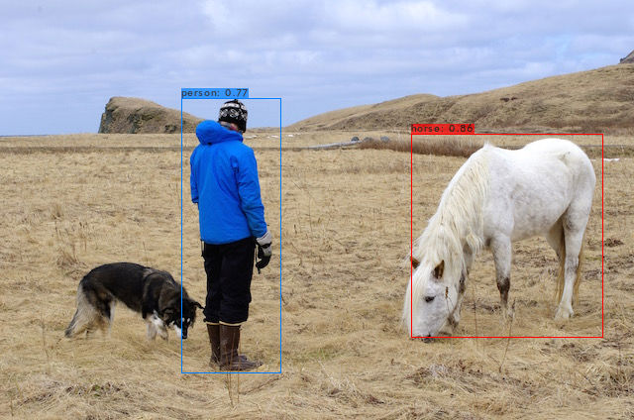
Original
Reduce 50% parameters

Slide 23
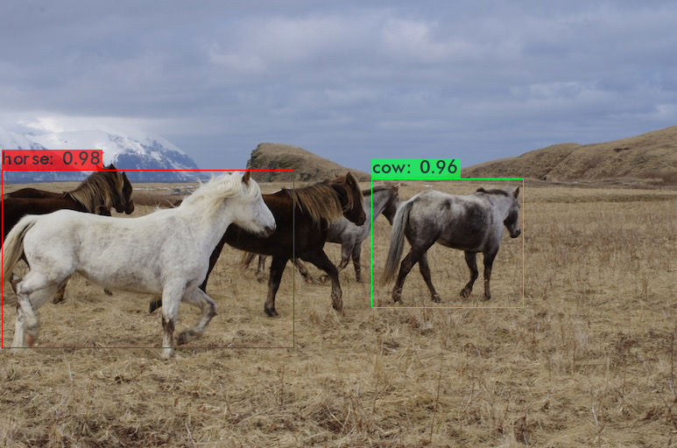
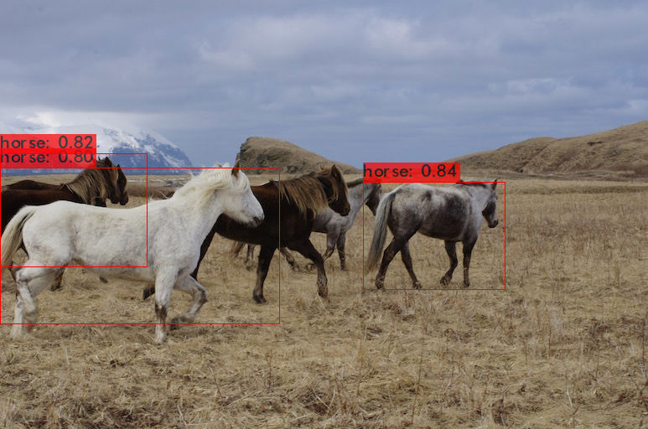
Original
Reduce 50% parameters

